Slide 1

18CSE392T – Machine Learning I
Unit III
Department of Data Science and Business Systems

Slide 2
Topics
Ridge Regression
Maximum likelihood estimation (least squares)
Principal Component Analysis (PCA)
Bayesian classifier
Support vector machine
Support vector machine + kernels
Multi class classification
K nearest neighbour classification
Application: face recognition with PCA
Department of Data Science and Business Systems

Slide 3
Regularization
Regularization is a technique used to reduce the error by fitting a model appropriately on a given training set and in turn helps to avoid over fitting
Regularization works by adding a penalty or complexity term to the complex model

Slide 4
Regularization
Let's consider the simple linear regression equation:
In the above equation,
Y represents the value to be predicted
X1, X2, …Xn are the features for Y
β0, β1,…..βn are the weights or magnitude attached to the features, respectively. Here represents the bias of the model, and b represents the intercept.
Linear regression models try to optimize the β0 and b to minimize the cost function.

Slide 5
Regularization
The equation for the cost function for the linear model is given below:
Now, we will add a loss function and optimize parameter to make the model that can predict the accurate value of Y.
The loss function for the linear regression is called as RSS or Residual sum of squares.
There are mainly two types of regularization techniques, which are given below:
Ridge Regression (L2 regularization)
Lasso Regression (L1 regularization)

Slide 6
Ridge Regression
Ridge regression is one of the types of linear regression in which a small amount of bias is introduced so that we can get better long-term predictions.
Ridge regression is a regularization technique, which is used to reduce the complexity of the model.
It is also called as L2 regularization.
In this technique, the cost function is altered by adding the penalty term to it.
The amount of bias added to the model is called Ridge Regression penalty.

Slide 7

Ridge Regression
We can calculate it by multiplying with the lambda to the squared weight of each individual feature.
The equation for the cost function in ridge regression will be:
In the above equation, the penalty term regularizes the coefficients of the model, and hence ridge regression reduces the amplitudes of the coefficients that decreases the complexity of the model.

Slide 8
Ridge Regression
As we can see from the above equation, if the values of λ tend to zero, the equation becomes the cost function of the linear regression model.
Hence, for the minimum value of λ, the model will resemble the linear regression model.
A general linear or polynomial regression will fail if there is high collinearity between the independent variables, so to solve such problems, Ridge regression can be used.
It helps to solve the problems if we have more parameters than samples.

Slide 9
Ridge Regression
Ridge regression is mostly used to reduce the overfitting in the model, and it includes all the features present in the model.
It reduces the complexity of the model by shrinking the coefficients.

Slide 10
Maximum likelihood estimation
The maximum likelihood estimation is a method that determines values for parameters of the model.
It is the statistical method of estimating the parameters of the probability distribution by maximizing the likelihood function.
The point in which the parameter value that maximizes the likelihood function is called the maximum likelihood estimate.
The goal of maximum likelihood estimation is to make inference about the population, which is most likely to have generated the sample i.e., the joint probability distribution of the random variables.

Slide 11
Maximum likelihood estimation
Difference between Likelihood and Probability:
Probability is simply the likelihood of an event happening.
S. No | Likelihood | Probability
1 | Refers to the past events with known outcomes | Refers to the occurrence of future events
2 | I flipped a coin 10 times and obtained 10 heads. What is the likelihood that the coin is fair? Given the fixed outcomes (data), what is the likelihood of different parameter values? | I flipped a coin 10 times. What is the probability of it landing heads or tails every time? Given the fixed parameter(p=0.5). What is the probability of different outcomes?
3 | Likelihoods doesn’t add up to 1 | Probabilities add up to 1

Slide 12
Maximum likelihood estimation
When the probability of a single coin toss is low in the range of 0% to 10%, Logistic regression is a model for binary classification real-time practical applications.
The parameters of a logistic regression model can be estimated by the probabilistic framework called maximum likelihood estimation.
A probability distribution for the target variable (labelled class) must be assumed and followed by a likelihood function defined that calculates the probability of observing the outcome given the input data and the model.
The function can be optimized to find the set of parameters that results in the largest sum likelihood over the training dataset.

Slide 13
Maximum likelihood estimation
In Maximum Likelihood Estimation, we maximize the conditional probability of observing the data (X) given a specific probability distribution and its parameters (theta – θ )
P(X, θ) where X is the joint probability distribution of all observations from 1 to n.
P(X1, X2, X3.…Xn; θ)
The resulting conditional probability is known as the likelihood of observing the data with the given model parameters and denoted as (L)
L(X, θ)

Slide 14
Maximum likelihood estimation
The objective of Maximum Likelihood Estimation is to find the set of parameters (theta) that maximize the likelihood function, e.g. result in the largest likelihood value.
maximize L(X ; θ)

Slide 15
Principal Component Analysis (PCA)
Principal Component Analysis is an unsupervised learning algorithm that is used for the dimensionality reduction in machine learning.
It is a statistical process that converts the observations of correlated features into a set of linearly uncorrelated features with the help of orthogonal transformation.
These new transformed features are called the Principal Components.
It is one of the popular tools that is used for exploratory data analysis and predictive modeling.
It is a technique to draw strong patterns from the given dataset by reducing the variances.

Slide 16
Principal Component Analysis (PCA)
Factor analysis, including both principal component analysis and common factor analysis, is a statistical approach that can be used to analyze interrelationships among a large number of variables and to explain these variables in terms of their common underlying dimensions (factors).
The objective is to find a way of condensing the information contained in a number of original variables into a smaller set of variates (factors) with a minimal loss of information.

Slide 17
Principal Component Analysis (PCA)
for example, to better understand the relationships between customers’ ratings of a fast-food restaurant.
Assume you ask customers to rate the restaurant on the following six variables:
food taste
food temperature
freshness
waiting time
cleanliness
friendliness of employees

Slide 18
Principal Component Analysis (PCA)
The analyst would like to combine these six variables into a smaller number.
By analyzing the customer responses,
The analyst might find that
The variables food taste, temperature, and freshness combine together to form a single factor of food quality | waiting time, cleanliness, and friendliness of employees combine to form another single factor, service quality
Single Factor
food quality Food taste Temperature Freshness | service quality Waiting time Cleanliness Friendliness of employees

Slide 19
Principal Component Analysis (PCA)
PCA generally tries to find the lower-dimensional surface to project the high-dimensional data.
PCA works by considering the variance of each attribute because the high attribute shows the good split between the classes, and hence it reduces the dimensionality.
Some real-world applications of PCA are image processing, movie recommendation system, optimizing the power allocation in various communication channels.
It is a feature extraction technique, so it contains the important variables and drops the least important variable.

Slide 20
Principal Component Analysis (PCA)
Principal Components in PCA
The transformed new features or the output of PCA are the Principal Components.
The number of these Principal Components are either equal to or less than the original features present in the dataset.
Some properties of these principal components are given below:
The principal component must be the linear combination of the original features.
These components are orthogonal, i.e., the correlation between a pair of variables is zero.
The importance of each component decreases when going to 1 to n, it means the 1 PC has the most importance, and n PC will have the least importance.

Slide 21
Principal Component Analysis (PCA)
Steps for PCA algorithm
Getting the dataset
Firstly, we need to take the input dataset and divide it into two subparts X and Y, where X is the training set, and Y is the validation set.
Representing data into a structure
Now we will represent our dataset into a structure. Such as we will represent the two-dimensional matrix of independent variable X. Here each row corresponds to the data items, and the column corresponds to the Features. The number of columns is the dimensions of the dataset.

Slide 22
Principal Component Analysis (PCA)
Steps for PCA algorithm
Standardizing the data
In this step, we will standardize our dataset. Such as in a particular column, the features with high variance are more important compared to the features with lower variance.
If the importance of features is independent of the variance of the feature, then we will divide each data item in a column with the standard deviation of the column. Here we will name the matrix as Z.
Calculating the Covariance of Z
To calculate the covariance of Z, we will take the matrix Z, and will transpose it. After transpose, we will multiply it by Z. The output matrix will be the Covariance matrix of Z.

Slide 23
Principal Component Analysis (PCA)
Steps for PCA algorithm
Calculating the Eigen Values and Eigen Vectors
Now we need to calculate the eigenvalues and eigenvectors for the resultant covariance matrix Z. Eigenvectors or the covariance matrix are the directions of the axes with high information. And the coefficients of these eigenvectors are defined as the eigenvalues.
Sorting the Eigen Vectors
In this step, we will take all the eigenvalues and will sort them in decreasing order, which means from largest to smallest. And simultaneously sort the eigenvectors accordingly in matrix P of eigenvalues. The resultant matrix will be named as P*.

Slide 24
Principal Component Analysis (PCA)
Steps for PCA algorithm
Calculating the new features Or Principal Components
Here we will calculate the new features. To do this, we will multiply the P* matrix to the Z. In the resultant matrix Z*, each observation is the linear combination of original features. Each column of the Z* matrix is independent of each other.
Remove less or unimportant features from the new dataset.
The new feature set has occurred, so we will decide here what to keep and what to remove. It means, we will only keep the relevant or important features in the new dataset, and unimportant features will be removed out.

Slide 25
Principal Component Analysis (PCA)
Applications
PCA is mainly used as the dimensionality reduction technique in various AI applications such as computer vision, image compression, etc.
It can also be used for finding hidden patterns if data has high dimensions. Some fields where PCA is used are Finance, data mining, Psychology, etc.

Slide 26
Classification
Classification is a task that requires the use of machine learning algorithms that learn how to assign a class label to examples from the problem domain
in other words
Classification is the process of recognizing, comprehending, and classifying things and thoughts into predetermined groups, sometimes known as “sub-populations.”
Machine learning systems use a variety of methods to classify future datasets into appropriate and relevant categories using these pre-categorized training datasets.

Slide 27
Classification
There are a couple of different types of classification task in machine learning, namely:
Binary Classification
Multi-Class Classification
Multi-Label Classification
Imbalanced Classification

Slide 28
Classification
Binary Classification
Classification problems with two class labels are referred to as binary classification.
In most binary classification problems, one class represents the normal condition and the other represents the aberrant condition.
Examples:
Email spam detection (spam or not).
Churn prediction (churn or not).
Conversion prediction (buy or not).
Popular algorithms that can be used for binary classification include:
Logistic Regression
k-Nearest Neighbors
Decision Trees
Support Vector Machine
Naive Bayes

Slide 29
Classification
Multi-Label Classification
Classification problems with two or more class labels, where one or more class labels may be anticipated for each case, are referred to as multi-label classification.
It differs from binary and multi-class classification, which predict a single class label for each case.
Examples:
Photo classification - “bicycle,” “apple,” “person,”, etc.,
Popular algorithms
Multi-label Decision Trees
Multi-label Random Forests
Multi-label Gradient Boosting

Slide 30
Classification
Imbalanced Classification
Imbalanced Classification refers to classification tasks where the number of examples in each class is unequally distributed.
Typically, imbalanced classification tasks are binary classification tasks where the majority of examples in the training dataset belong to the normal class and a minority of examples belong to the abnormal class.
Examples:
Fraud detection.
Outlier detection.
Medical diagnostic tests.
Popular algorithms
Cost-sensitive Logistic Regression.
Cost-sensitive Decision Trees.
Cost-sensitive Support Vector Machines.

Slide 31
Multi-Class Classification
Classification jobs with more than two class labels are referred to as multi-class classification.
Multiclass classification in machine learning, unlike binary classification, does not distinguish between normal and pathological results.
Instead, examples are assigned to one of a number of pre-defined classes.
Examples:
Face classification.
Plant species classification.
Optical character recognition.
Popular algorithms
k-Nearest Neighbors.
Decision Trees.
Naive Bayes.
Random Forest.
Gradient Boosting

Slide 32
Multi-Class Classification
Unlike binary classification, multi-class classification does not have the notion of normal and abnormal outcomes.
Instead, examples are classified as belonging to one among a range of known classes.
The number of class labels may be very large on some problems.
For example, a model may predict a photo as belonging to one among thousands or tens of thousands of faces in a face recognition system.
Problems that involve predicting a sequence of words, such as text translation models, may also be considered a special type of multi-class classification. Each word in the sequence of words to be predicted involves a multi-class classification where the size of the vocabulary defines the number of possible classes that may be predicted and could be tens or hundreds of thousands of words in size.

Slide 33
Multi-Class Classification
It is common to model a multi-class classification task with a model that predicts a Multinoulli probability distribution for each example.
The Multinoulli distribution is a discrete probability distribution that covers a case where an event will have a categorical outcome, e.g. K in {1, 2, 3, …, K}. For classification, this means that the model predicts the probability of an example belonging to each class label.

Slide 34
K nearest neighbour classification
K-Nearest Neighbour is one of the simplest Machine Learning algorithms based on Supervised Learning technique.
K-NN algorithm assumes the similarity between the new case/data and available cases and put the new case into the category that is most similar to the available categories.
K-NN algorithm stores all the available data and classifies a new data point based on the similarity. This means when new data appears then it can be easily classified into a well suite category by using K- NN algorithm.
K-NN algorithm can be used for Regression as well as for Classification but mostly it is used for the Classification problems.

Slide 35
K nearest neighbour classification
K-NN is a non-parametric algorithm, which means it does not make any assumption on underlying data.
It is also called a lazy learner algorithm because it does not learn from the training set immediately instead it stores the dataset and at the time of classification, it performs an action on the dataset.
KNN algorithm at the training phase just stores the dataset and when it gets new data, then it classifies that data into a category that is much similar to the new data.

Slide 36
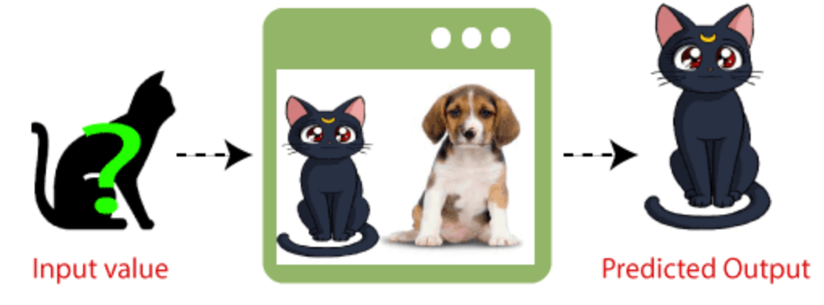
K nearest neighbour classification
Example: Suppose, we have an image of a creature that looks similar to cat and dog, but we want to know either it is a cat or dog. So for this identification, we can use the KNN algorithm, as it works on a similarity measure. Our KNN model will find the similar features of the new data set to the cats and dogs images and based on the most similar features it will put it in either cat or dog category.

Slide 37
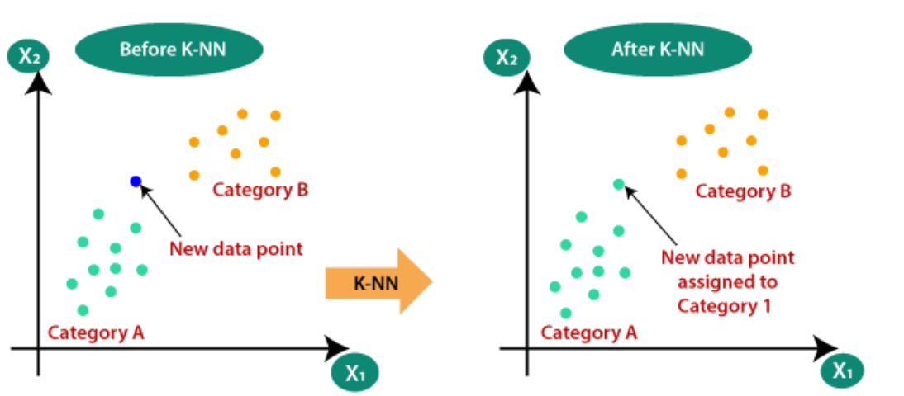
K nearest neighbour classification
Suppose there are two categories, i.e., Category A and Category B, and we have a new data point, so this data point will lie in which of these categories. To solve this type of problem, we need a K-NN algorithm. With the help of K-NN, we can easily identify the category or class of a particular dataset. Consider the below diagram:

Slide 38
K nearest neighbour classification
How does K-NN work?
Step-1: Select the number K of the neighbors
Step-2: Calculate the Euclidean distance of K number of neighbors
Step-3: Take the K nearest neighbors as per the calculated Euclidean distance.
Step-4: Among these k neighbors, count the number of the data points in each category.
Step-5: Assign the new data points to that category for which the number of the neighbor is maximum.
Step-6: Our model is ready.

Slide 39
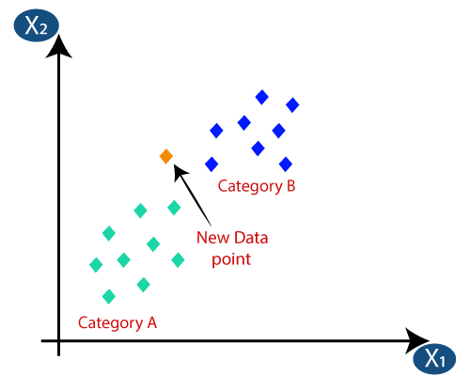
K nearest neighbour classification
How does K-NN work?
Suppose we have a new data point and we need to put it in the required category. Consider the below image:

Slide 40
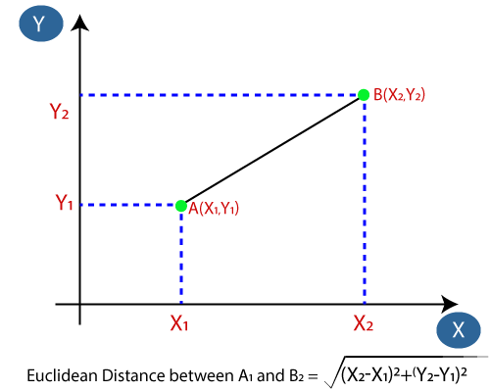
K nearest neighbour classification
How does K-NN work?
Firstly, we will choose the number of neighbors, so we will choose the k=5.
Next, we will calculate the Euclidean distance between the data points. The Euclidean distance is the distance between two points, which we have already studied in geometry. It can be calculated as:

Slide 41
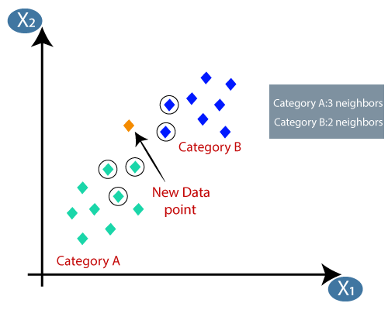
K nearest neighbour classification
How does K-NN work?
By calculating the Euclidean distance we got the nearest neighbors, as three nearest neighbors in category A and two nearest neighbors in category B. Consider the below image:
As we can see the 3 nearest neighbors are from category A, hence this new data point must belong to category A.

Slide 42
K nearest neighbour classification
How to select the value of K in the K-NN Algorithm?
There is no particular way to determine the best value for "K", so we need to try some values to find the best out of them.
The most preferred value for K is 5.
A very low value for K such as K=1 or K=2, can be noisy and lead to the effects of outliers in the model.
Large values for K are good, but it may find some difficulties.

Slide 43
K nearest neighbour classification
Advantages of KNN Algorithm:
It is simple to implement.
It is robust to the noisy training data
It can be more effective if the training data is large.
Disadvantages of KNN Algorithm:
Always needs to determine the value of K which may be complex some time.
The computation cost is high because of calculating the distance between the data points for all the training samples.

Slide 44
Face Recognition with PCA
Principle Component Analysis PCA is a classical feature extraction and data representation technique widely used in pattern recognition.
It is one of the most successful techniques in face recognition.
PCA is an algorithm of unsupervised learning and widely used to reduce the dimension of the data.
PCA is an orthogonal linear transformation which means that PCA can transform data into a new coordinate system such that the greatest variance by some scalar projection of the data comes to lie on the first principal component, the second greatest variance on the second principal component, and so on.
This is also called the process of dimensional reduction.
https://www.kaggle.com/code/atulyakumar98/face-recognition-using-pca-and-mlp/notebook

Slide 45
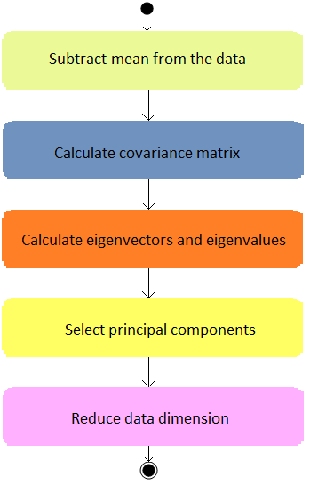
Face Recognition with PCA

